Slide 1
Sound Card
SUBMITTED BY:- SUBMITTED TO-:
ONISH GARG HINA MAM
CLASS: B.Voc.(SD)I (Assistant Professor)
ROLL NO.1615916 Comp. Sci. & App. Dept.

Slide 2
Definition-:
Most of our music collection is probably in digital format, either on CDs or as files on our computer. In order to be able to listen to our music, a sound card converts digital data to analog sound waves that we can hear. The output signal is then connected to a headphone or set of speakers. We can also use a sound card to record audio with a microphone.

Slide 3
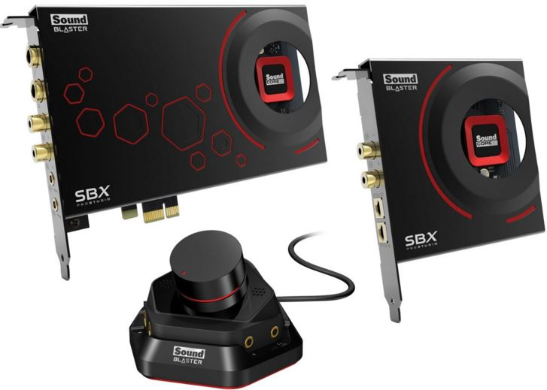

Slide 4
Sound Card Features and Functions
The motherboard on most computer systems has an integrated sound card, which is often sufficient for many users. However, to get higher quality sound we can upgrade to a separate sound card, which uses better and more expensive components.
Audio files on a computer consist of digital data just like any other file on a computer. Sounds we can hear consist of waves that travel through the air - sounds are analog. The primary function of a sound card is to translate between digital and analog information, just like a video card. Sound cards typically have four major components:

Slide 5
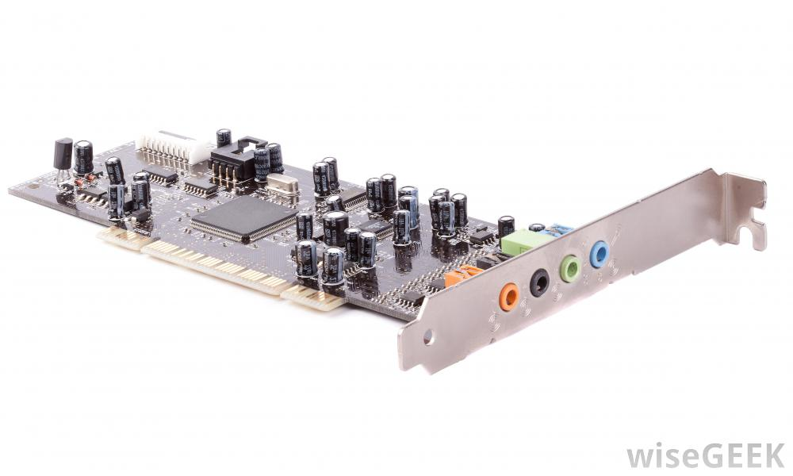

Slide 6
The digital-to-analog converter (DAC), which makes it possible to convert digital data to analog sound.
The analog-to-digital converter (ADC), which makes it possible to make digital recordings from analog sound inputs.
An interface to connect to the motherboard, typically using Peripheral Component Interconnect (PCI).
Input and output connectors so you can plug in headphones, speakers or a microphone - many computer systems have speakers and microphone built-in, but connectors allow you to use higher quality external devices to play or record sound.

Slide 7
Speakers

Slide 8
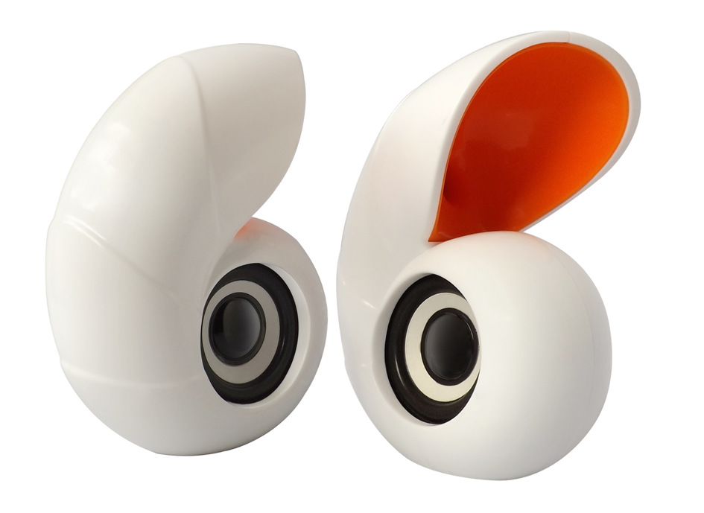

Slide 9
Definition-:
Speakers are popular output devices used with computer systems. They receive audio input from the computer's sound card and produce audio output in the form of sound waves. Most computer speakers are active speakers, meaning they have an internal amplifier which allows us to increase the volume, or amplitude, of the sound. Speakers usually come in pairs, which allows them to produce stereo sound from two separate audio channels.

Slide 10
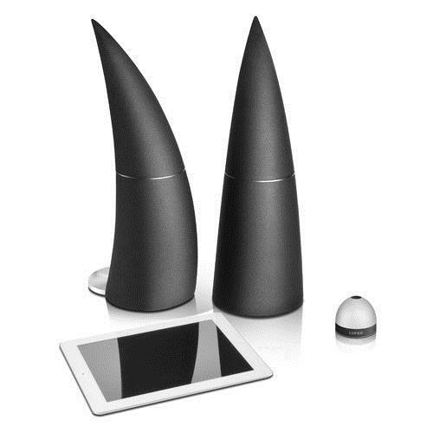

Slide 11
Function-:
The most basic reason for computer sound is notifications, like when you receive an email or when you attempt to open a window or close a file when you can't really do that. Maybe the best function of a computer speaker is music and other audio.

